Slide 1


Slide 2
Paging & Ordering

Slide 3

Paging
If you have used the internet, you are familiar with the concept of paging
No, not that kind of paging..
Notes:
Can be found online… but I can’t link to it

Slide 4
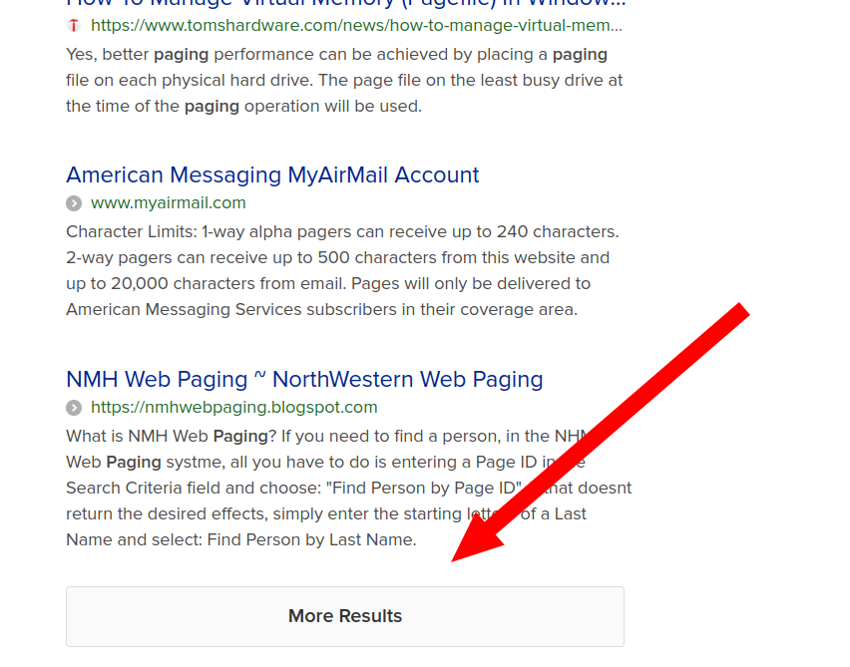
Paging
This kind of paging
Notes:
Can be found online… but I can’t link to it

Slide 5
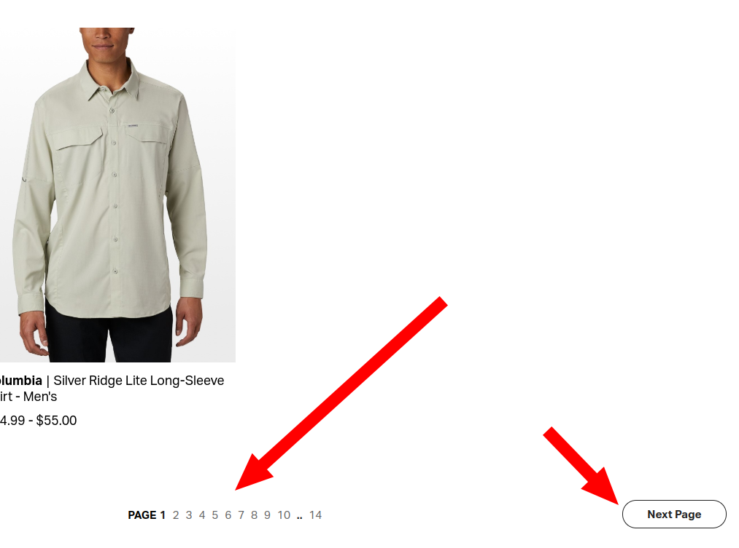
Paging
And this kind of paging
Notes:
Can be found online… but I can’t link to it

Slide 6
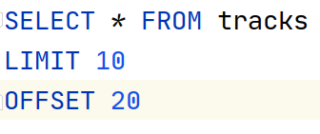
Paging
SQL Database typically have support for a notion of paging
It is not, however, part of the SQL standard
In SQLite there are two optional clauses in the SELECT statement:
LIMIT - limits the number of results
OFFSET - takes an offset to start at
Notes:
Can be found online… but I can’t link to it

Slide 7
Paging
Note that these can be used independently
LIMIT, in particular, might be used to limit a search page to only N results
Notes:
Can be found online… but I can’t link to it

Slide 8
Paging
Offset is the total offset in records, not pages
So in this case we are looking at page 3 of a system that is showing 10 items at a time:
OFFSET 0 - page 1
OFFSET 10 - page 2
OFFSET 20 - page 3
Notes:
Can be found online… but I can’t link to it

Slide 9
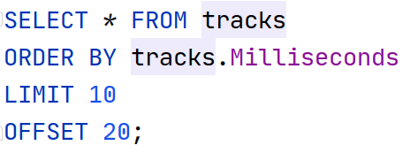
Ordering
You often wish to order the data you are displaying
For example, maybe you allow sorting by different columns
This is accomplished with the ORDER BY clause in SQL
Notes:
Can be found online… but I can’t link to it

Slide 10
Ordering
You can order by any column in your query
Note that in aggregate queries you must order by an attribute in the final results
Notes:
Can be found online… but I can’t link to it

Slide 11
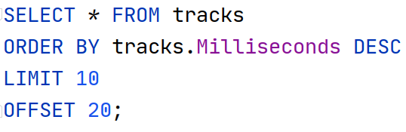
Ordering - Direction
By default, ordering is done in an ascending direction
If you want to order in the descending direction, you can add the DESC
You can also use the ASC keyword if you wish to be explicit about ascending order
Notes:
Can be found online… but I can’t link to it

Slide 12
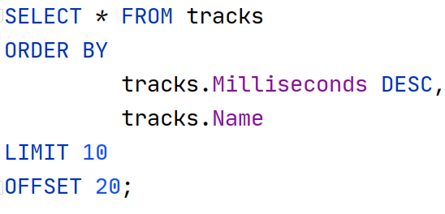
Ordering - Multiple Columns
If you wish to order by multiple columns, you can use comma separated ordering specifications
Order by milliseconds, descending and if two tracks are equal in length order them by name, ascending
Notes:
Can be found online… but I can’t link to it

Slide 13
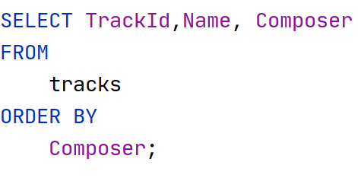
Ordering - Nulls
Our old friend NULL
What does NULL mean when ordering values?
Kinda depends…
By default NULL is considered “first” in SQLite
Notes:
Can be found online… but I can’t link to it

Slide 14
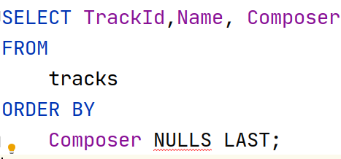
Ordering - Nulls
If you want the opposite behavior you can use the NULLS LAST qualifier in an ORDER BY clause
Notes:
Can be found online… but I can’t link to it

Slide 15
Ordering - Nulls
Note that NULLS LAST means literally: NULLS LAST
If you run a DESC order with the clause, nulls will still show up at the end of the query
This is SQLite specific stuff, a different DB may have dramatically different behavior
Notes:
Can be found online… but I can’t link to it

Slide 16
EXPLAIN
Learning how a query will execute

Slide 17
Explain
As we have discussed before, SQL is a declarative rather than an imperative language
SQL tells the database what you want, not how to get it
But sometimes you want to know how the DB will get it
Mainly for perf reasons
Notes:
Can be found online… but I can’t link to it

Slide 18
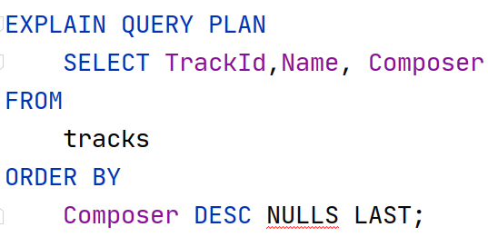
Explain
To learn how a query is going to execute, you can use the EXPLAIN QUERY PLAN statement
Notes:
Can be found online… but I can’t link to it

Slide 19
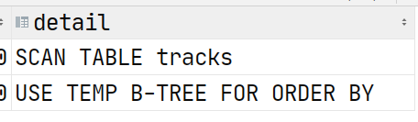
Explain
The results for this query are interesting!
The DB will do a table scan
The DB will then create a temporary B-Tree (a data structure) for ordering the results
Notes:
Can be found online… but I can’t link to it

Slide 20
Explain
That’s unfortunate that we need to create a temporary B-Tree
We can fix that by adding an index on that column
We will discuss indexes (and B-Trees) in more depth later
For now, just assume they mean “fast access”
Notes:
Can be found online… but I can’t link to it

Slide 21
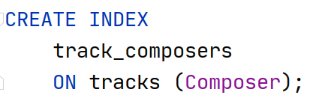
Explain
Adding an index is pretty simple
Notes:
Can be found online… but I can’t link to it

Slide 22
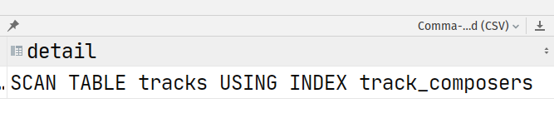
Explain
And now our query is more efficient!
No temporary B-Trees needed!
Awesome!
Notes:
Can be found online… but I can’t link to it

Slide 23

Optimization
“The real problem is that programmers have spent far too much time worrying about efficiency in the wrong places and at the wrong times; premature optimization is the root of all evil (or at least most of it) in programming.”
-- Donald Knuth
Notes:
Can be found online… but I can’t link to it

Slide 24
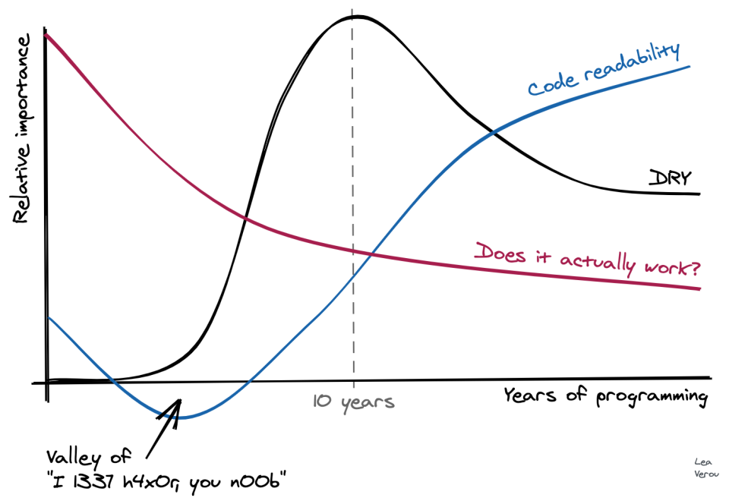
Optimization
“The real problem is that programmers have spent far too much time worrying about efficiency in the wrong places and at the wrong times; premature optimization is the root of all evil (or at least most of it) in programming.”
-- Donald Knuth
Notes:
Can be found online… but I can’t link to it

Slide 25
Paging, Ordering & Explain Summary
You can page data in SQLite (not SQL) using the LIMIT/OFFSET clauses
You can order your results with the ORDER BY clause (standard SQL)
Null hanlding can be tricky, definitely non-standard
If you want to see the implementation of a query, the EXPLAIN QUERY PLAN statement will tell you how SQLite is going to implement a given query
With that information, you can make optimization decisions

